Slide 1



Multi-Cloud Mastery: AWS & Azure
Kimi AI

Slide 2



01
Mission & Strategy
04
DevOps Pipeline
2
2
02
AWS Deployment
05
Validation & Insights
2
2
03
Azure Deployment
06
Next Steps

Slide 3


PART 01
01
Mission & Strategy

Slide 4

Project Mission & Scope
Deploy a production-grade Streamlit app on AWS and Azure to prove true multi-cloud capability, resilience, and automation.
Zero-Downtime Updates
Multi-Cloud Parity
Unified CI/CD
Identical user experiences across both platforms.
A single GitHub Actions pipeline drives both clouds.
Seamless updates with no service interruption.

Slide 5
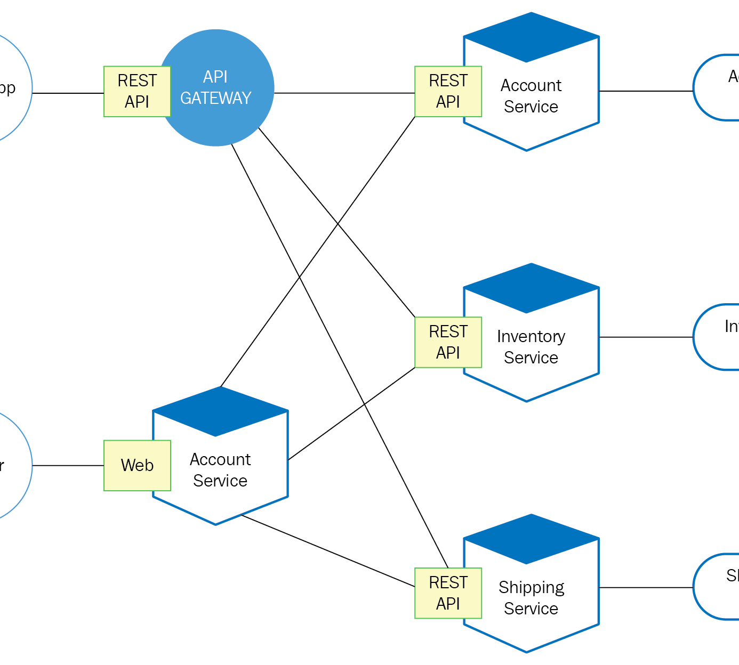
Why Multi-Cloud Matters
Avoid vendor lock-in, enhance resilience, and meet global compliance by strategically distributing workloads across independent cloud providers.
Avoid Vendor Lock-in
Maintain flexibility and leverage the best services from each provider.
Maximize Uptime
Achieve enterprise-grade redundancy without doubling operational overhead.

Slide 6
PART 02
02
AWS Deployment

Slide 7
AWS: Elastic Beanstalk Design
Chosen for its native Python support and ability to abstract complex infrastructure while retaining control.
Simple Procfile
Managed PaaS
Rapid Deployment
A single command tells EB how to launch the app.
Abstracts EC2, load balancers, and auto-scaling.
Turns Git pushes into production releases in minutes.

Slide 8

Security & Cost Controls
Implementing best practices for a secure and cost-effective deployment on AWS.
Least-Privilege IAM
A dedicated CI/CD user with restricted permissions minimizes the blast radius in case of credential compromise.
Cost-Efficiency
T2.micro instances balance performance and cost, while auto-scaling policies automatically absorb traffic spikes.

Slide 9
PART 03
03
Azure Deployment

Slide 10
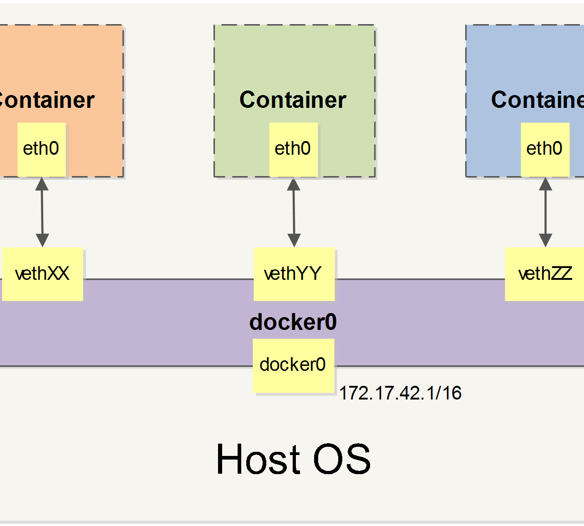
Azure: Container-First
Leveraging Docker for total portability and consistent runtime from development to production.
Total Portability
Guarantees identical runtime environment everywhere.
Immutable Versions
ACR stores images for instant rollbacks without rebuilding.
Multi-Stage Build
Minimizes image size and attack surface for security.

Slide 11
Managed Identity Security
Eliminating password management and enhancing security with Azure's system-assigned managed identity.
Azure Web App
Secure Authentication
ACR Registry
System-Assigned Identity
No passwords in code
AcrPull Role Assignment
This ensures the App Service authenticates securely within the Azure backbone without managing any sensitive credentials.

Slide 12
PART 04
04
DevOps Pipeline

Slide 13
Unified GitHub Actions Flow
One YAML file orchestrates deployments to both clouds simultaneously, triggered automatically on every push to the main branch.
1. Git Push
2. Build & Test
3. Parallel Deploy
AWS Elastic Beanstalk
Azure Container Apps

Slide 14

Secretless Authentication
No sensitive data is stored in the codebase. All credentials are managed securely using GitHub Secrets and injected at runtime.
AWS_ACCESS_KEY_ID: For S3 and Beanstalk access.
AZURE_CREDENTIALS: JSON for Service Principal authentication.
ACR_PASSWORD: For pushing Docker images to Azure Container Registry.

Slide 15
PART 05
05
Validation & Insights

Slide 16
Multi-Cloud Validation & Parity
Automated smoke tests confirm identical performance, functionality, and resilience across both cloud platforms.
Performance
Traffic Splitting
Disaster Recovery
<200ms
50-50
Instant
Average Latency
Routing Confirmed
Independent Rollback

Slide 17
Lessons Learned: AWS vs. Azure
AWS Strengths
Azure Strengths
Granular Control: Deeper infrastructure knobs for fine-tuning.
Elastic Beanstalk: Makes Python deployment intuitive for developers.
Trade-off: Requires explicit S3 management for artifacts.
Container Experience: Superior, smoother workflow for Docker-based apps.
Managed Identity: Simplifies security by eliminating password management.
Trade-off: Container build times add slight overhead to the pipeline.

Slide 18
PART 06
06
Next Steps

Slide 19
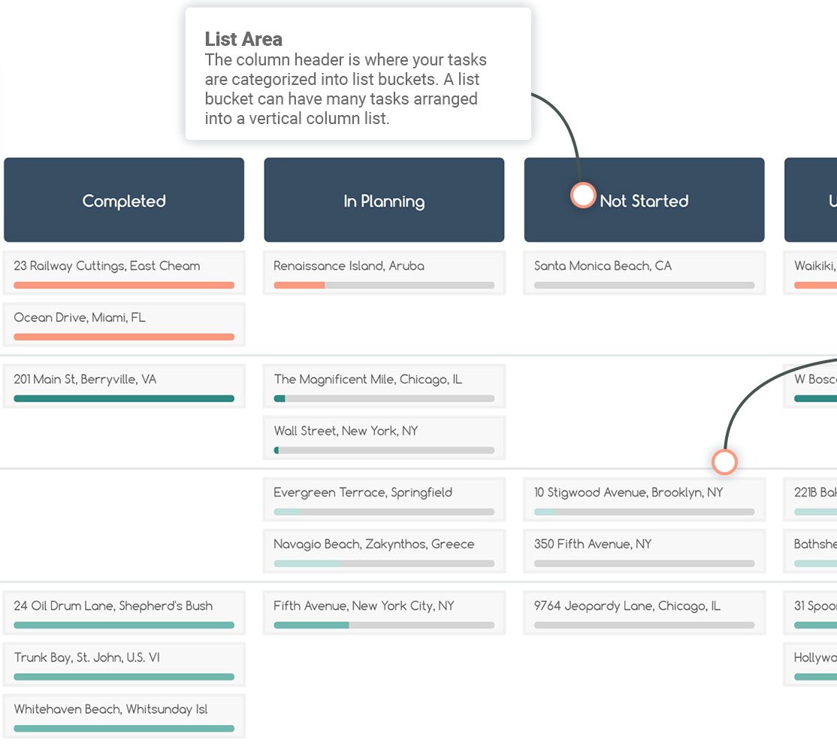
Scale & Optimize Roadmap
The journey doesn't end here. The next steps focus on repeatability, security, and cost optimization.
1
Infrastructure as Code: Introduce Terraform modules for fully repeatable infrastructure.
2
Advanced Deployment: Implement canary releases with CodeDeploy and Deployment Slots.
3
Cost Monitoring: Utilize native cost management tools to drive rightsizing decisions.

Slide 20
Ready to Go Multi-Cloud?
Fork the repository, inspect the open-source pipeline, and deploy your own multi-cloud app today. Let's build a community blueprint for portable, secure, and cost-effective cloud-native applications.
Fork & Deploy
Share & Contribute
Share Telemetry
Start with our template.
Join the community.
Help us improve.

Slide 21
ＴＨＡＮＫＳ
Kimi AI

